Slide 1
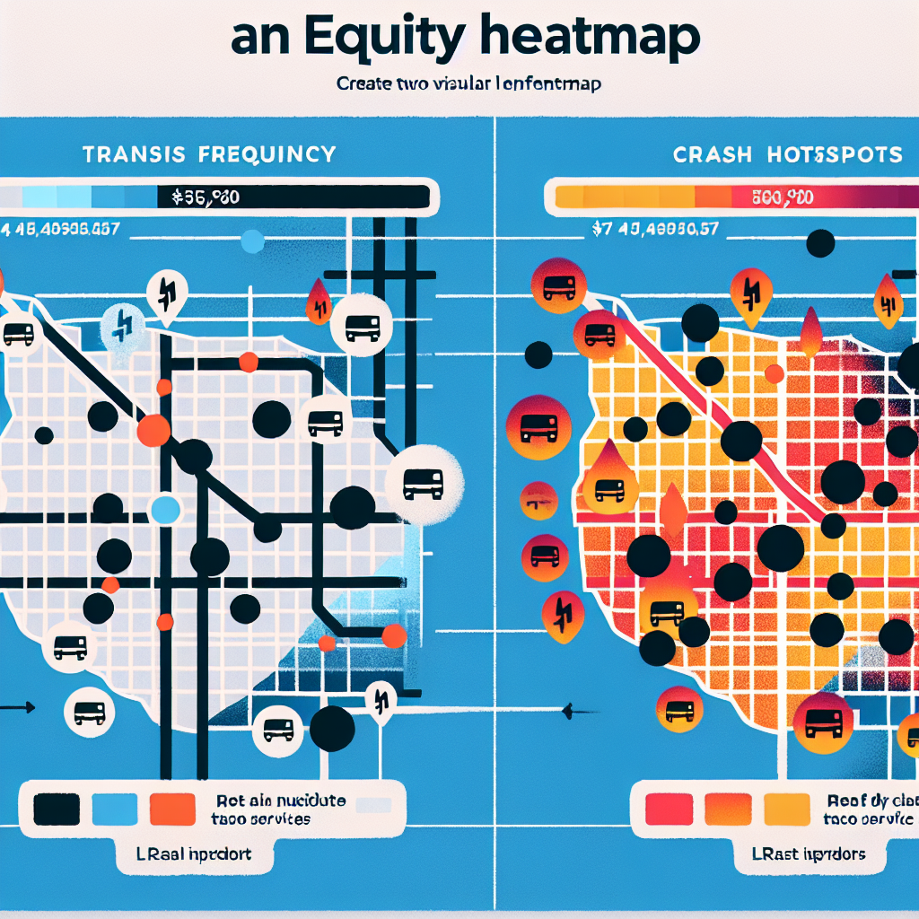
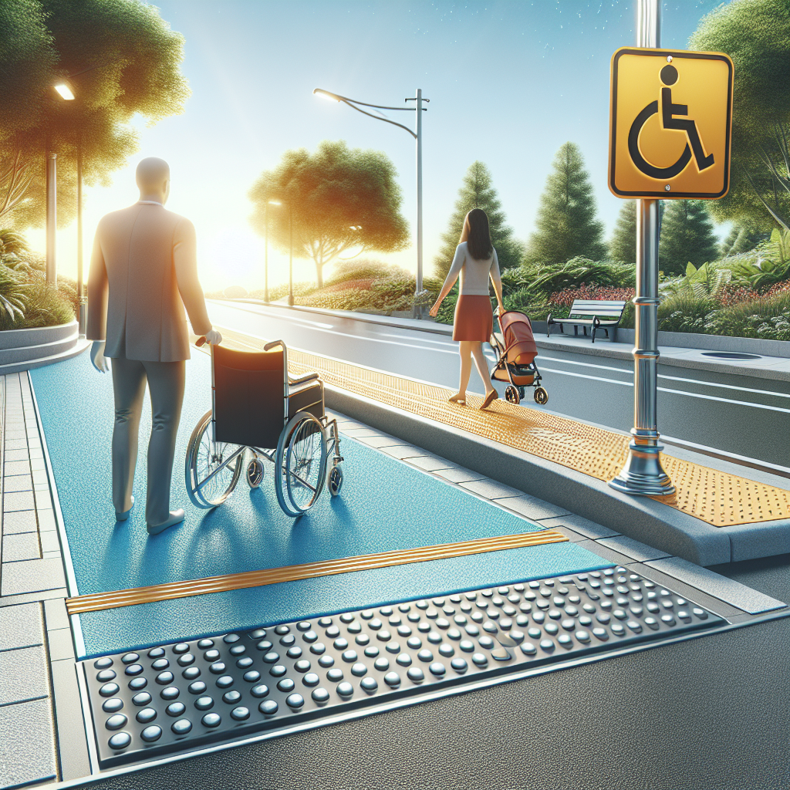
Equity & Accessibility
Invest first in underserved neighborhoods (access deserts).
Zero‑fare/transit discounts for low‑income riders and youth.
Anti‑displacement: community land trusts, right‑to‑return, rent stabilization tools.
Safe routes to school and late‑night worker corridors.
Community co‑design: multilingual workshops, stipends, childcare.
Continuous curb ramps and tactile guidance at crossings.
Audible signals; seating every 100–150 m; shade and lighting.
Step‑free building entries; wider doorways; at‑grade transit boarding.

